Slide 1

The Centrosome: A Cell's Microtubule Organizing Center

Slide 2
Structure of a Centrosome
Centrioles
Pericentriolar Material
Two barrel-shaped structures made of microtubules. They are arranged at right angles to each other.
A dense, protein-rich matrix surrounding the centrioles. It contains proteins that regulate microtubule nucleation and organization.

Slide 3

Function of a Centrosome
Microtubule Organizing Center (MTOC)
Cellular Organization
Centrosomes help maintain cell shape, polarity, and intracellular transport.
The centrosome serves as the main MTOC in animal cells. It nucleates, anchors, and organizes microtubules.

Slide 4
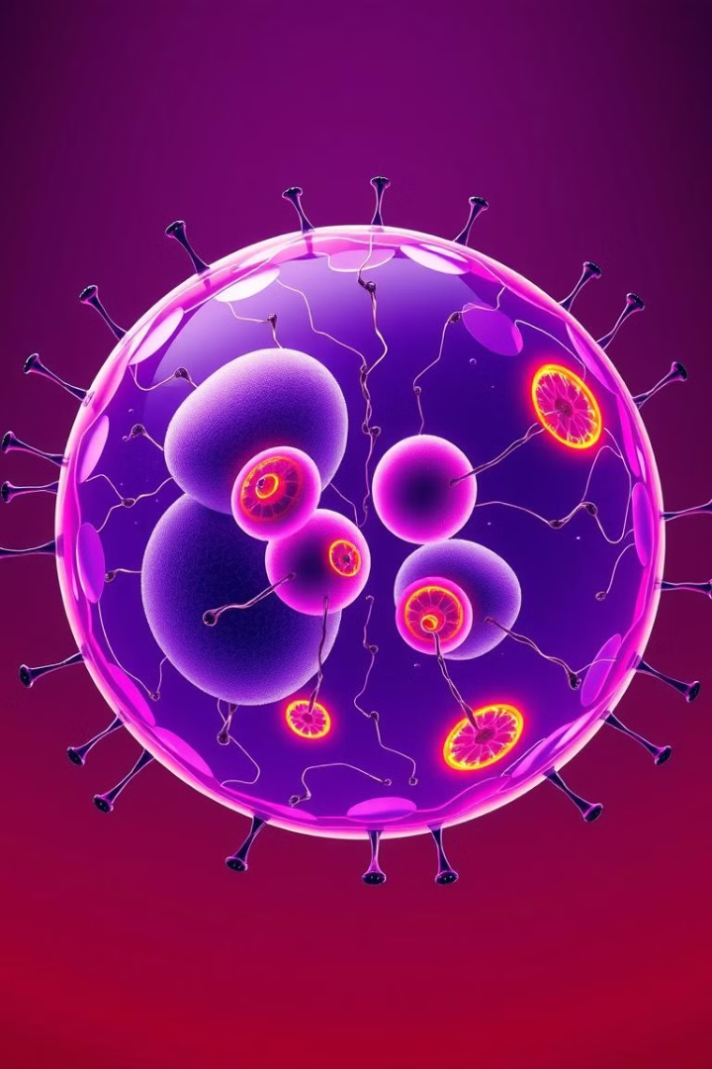


Role in Cell Division
Spindle Pole Formation
Chromosome Segregation
Centrosomes duplicate and migrate to opposite poles of the cell. They form spindle poles to which microtubules attach.
Microtubules emanating from the centrosomes attach to chromosomes and pull them apart during mitosis and meiosis.

Slide 5
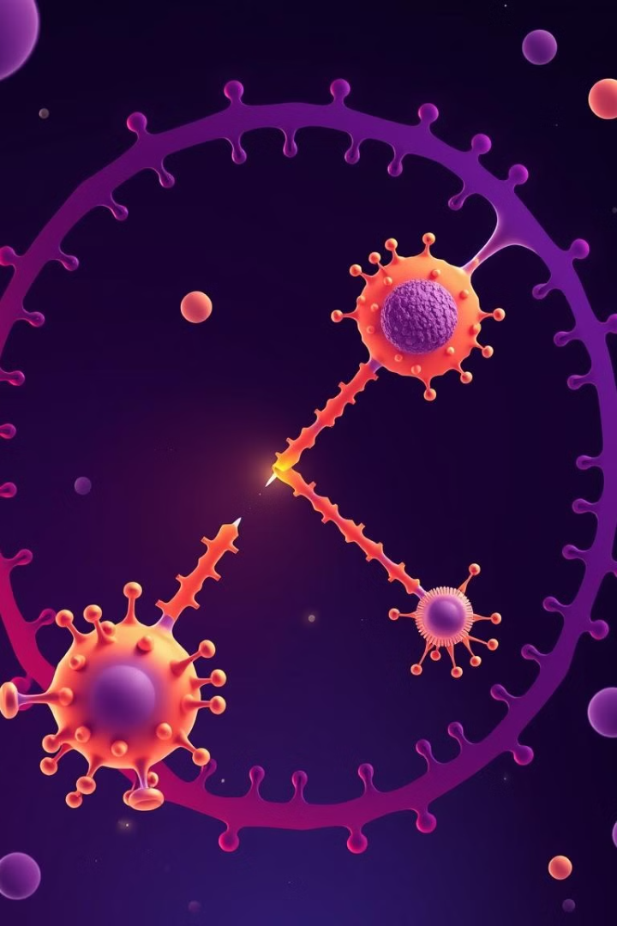
Centrosome Duplication and Separation
1
Centriole duplication occurs during the S phase of the cell cycle.
2
Newly formed centrioles are linked to their parental centrioles. These pairs migrate to opposite poles of the cell.
3
Microtubule formation and spindle assembly occur as the cell prepares for division.

Slide 6

Centrosome Abnormalities and Disease
Cancer
Neurological Disorders
Centrosome amplification and dysfunction are associated with increased proliferation and tumor formation.
Abnormal centrosome function has been linked to neurodegenerative diseases such as Alzheimer's and Parkinson's.
Developmental Defects
Centrosome defects can disrupt embryonic development and lead to congenital malformations.

Slide 7



Centrosome Regulation and Signaling
Cyclin-Dependent Kinases (CDKs)
1
Regulate centrosome duplication and separation.
Microtubule-Associated Proteins (MAPs)
2
Control microtubule dynamics and stability.
Signaling Pathways
3
Regulate centrosome function through various signaling cascades.

Slide 8
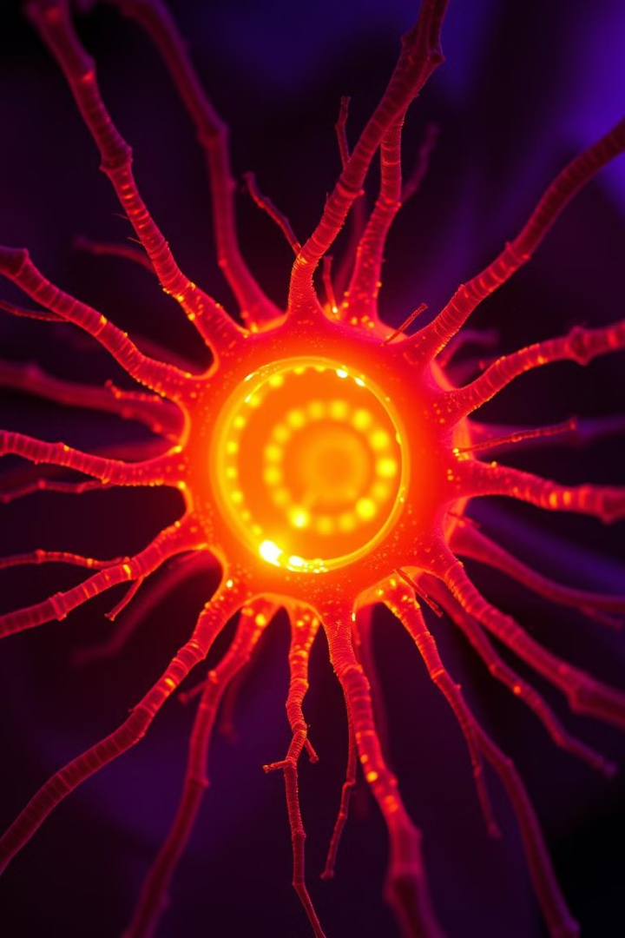



Future Directions in Centrosome Research
Centrosome-Targeted Therapies
Developing drugs that specifically target centrosome function to treat diseases like cancer.
Centrosome Engineering
Exploring the possibility of manipulating centrosome function to improve tissue regeneration or create artificial tissues.
Centrosome Evolution
Understanding the evolution of centrosomes and their role in the diversification of eukaryotic life.

